Slide 1
THE BASICS OF NEURAL NETS
Bryan Pardo
CS 349
Northwestern University
(updated spring 2019)

Slide 2
Deep Nets (AKA Neural Nets)
Machine learners
made of simple functions
Organized in layers
Very popular

Slide 3
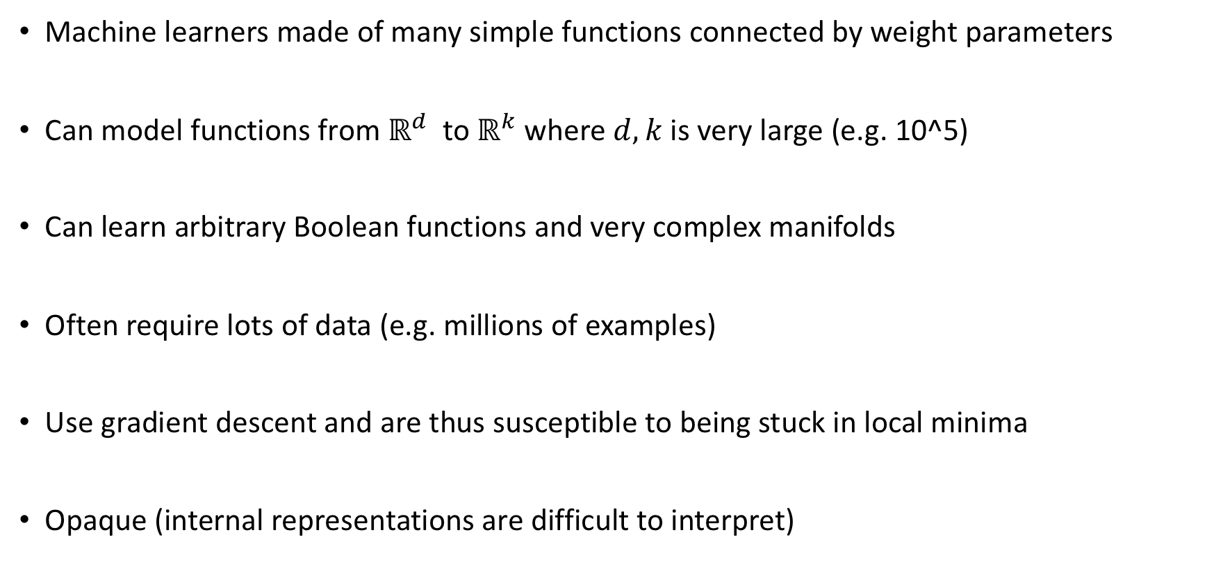
Deep Nets (AKA Neural Nets)
Machine learners made of many simple functions connected by weight parameters
Can model functions from $ℝ^{d}$ to $ℝ^{k}$ where $d,k$is very large (e.g. 10^5)
Can learn arbitrary Boolean functions and very complex manifolds
Often require lots of data (e.g. millions of examples)
Use gradient descent and are thus susceptible to being stuck in local minima
Opaque (internal representations are difficult to interpret)

Slide 4
Why I care about deep nets
They are key technology that is enables state of the art performance in….
Image recognition (e.g. Facebook and Google image labeling)
Speech recognition (Cortana)
Machine translation (Google Translate)
Playing video games (Why are we automating this?)
Playing board games (e.g. AlphaGo)
Notes:
mmmmm

Slide 5
The Perceptron
Rosenblatt, Frank. "The perceptron: A model for information storage and organization in the brain." Psychological review 65.6 (1958): 386.

Slide 6
The Perceptron
Rosenblatt, F. (1958). The perceptron: A probabilistic model for information storage and organization in the brain. Psychological Review, 65(6), 386-408
The “first wave” in neural networks
A linear classifier

Slide 7
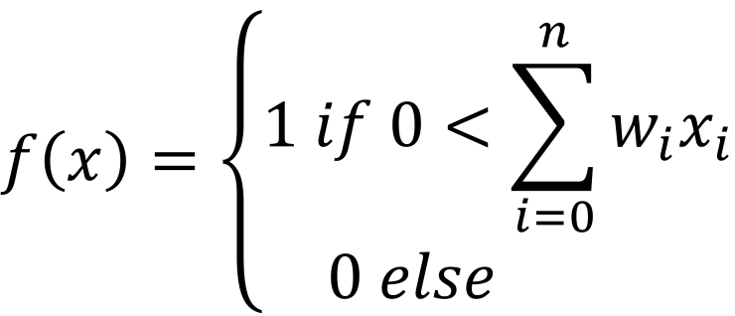
A single perceptron
x₁
x₀
Bias x₀=1
w₁
w₀
x₂
w₂
$$f\left(x\right)=\left\{\begin{matrix}1 if 0<\sum_{i=0}^{n}{w_{i}x_{i}} \\ 0 else \end{matrix}\right.$$
Input vector
x₃
w₃
x₄
w₄
Step function
output
x₅
w₅
Sum of weighted input

Slide 8
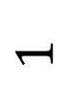
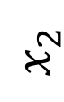
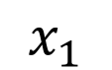
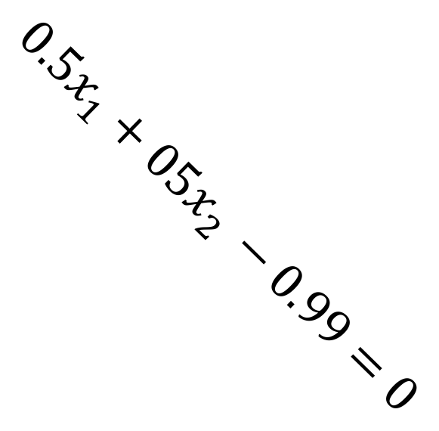
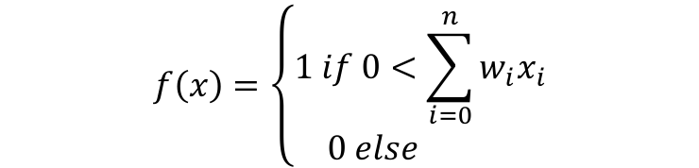
Weights define a hyperplane in the input space
$$1$$
1
1 region
-0.99
x₁
0.5
$$f\left(x\right)=\left\{\begin{matrix}1 if 0<\sum_{i=0}^{n}{w_{i}x_{i}} \\ 0 else \end{matrix}\right.$$
$${0.5x}_{1}+{05x}_{2 }−0.99=0$$
$$x_{2}$$
x₂
0.5
0 region
AND
0
$$x_{1}$$
1

Slide 9
Classifies any (linearly separable) data
$$1$$
1
1 region
-0.99
x₁
0.5
$$f\left(x\right)=\left\{\begin{matrix}1 if 0<\sum_{i=0}^{n}{w_{i}x_{i}} \\ 0 else \end{matrix}\right.$$
$${0.5x}_{1}+{05x}_{2 }−0.99=0$$
$$x_{2}$$
x₂
0.5
0 region
AND
0
$$x_{1}$$
1

Slide 10
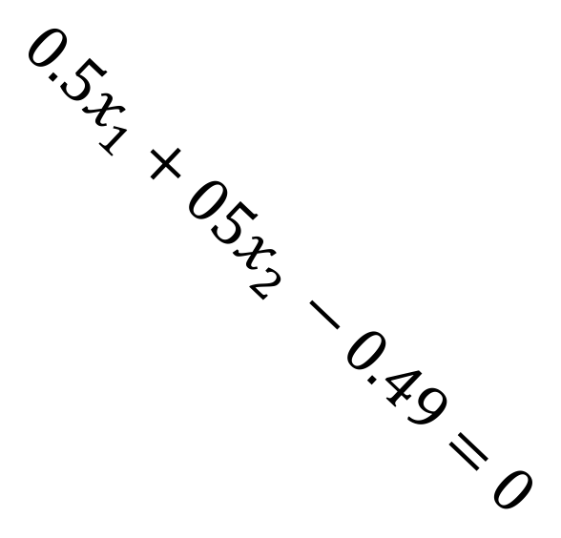
Different logical functions are possible
$$1$$
1
-0.49
x₁
0.5
1 region
$$f\left(x\right)=\left\{\begin{matrix}1 if 0<\sum_{i=0}^{n}{w_{i}x_{i}} \\ 0 else \end{matrix}\right.$$
$$x_{2}$$
x₂
$${0.5x}_{1}+{05x}_{2 }−0.49=0$$
0.5
0 region
OR
0
$$x_{1}$$
1

Slide 11

And, Or, Not are easy to define
$$1$$
1
0 region
0
x₁
0
$${−x}_{2}=0$$
$$f\left(x\right)=\left\{\begin{matrix}1 if 0<\sum_{i=0}^{n}{w_{i}x_{i}} \\ 0 else \end{matrix}\right.$$
$$x_{2}$$
x₂
-1
1 region
NOT
-1

Slide 12
One perceptron: Only linear decisions
This is XOR.
It can’t learn XOR.

Slide 13
Combining perceptrons can make any Boolean function
x₀
0
x₁
0.6
x₀
1
1
XOR
-0.6
x₀
-0.6
0
1
x₂
0.6
…if you can set the weights & connections right

Slide 14
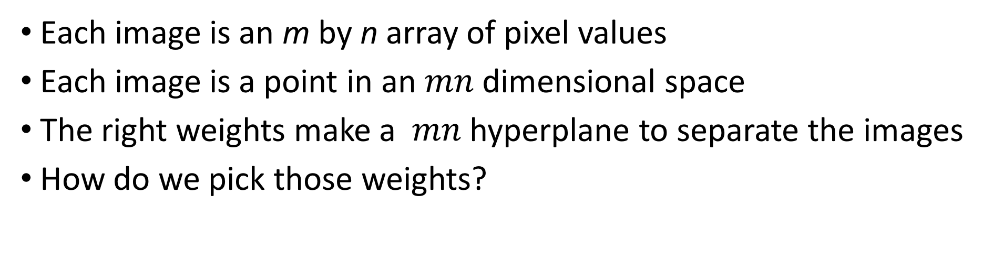
Classifying image data with a single perceptron
Each image is an m by n array of pixel values
Each image is a point in an $mn$ dimensional space
The right weights make a $mn$ hyperplane to separate the images
How do we pick those weights?

Slide 15
Classifying image data with a single perceptron
Each image is an m by n array of pixel values
Each image is a point in an $mn$ dimensional space
The right weights make a $mn$ hyperplane to separate the images
How do we pick those weights?

Slide 16
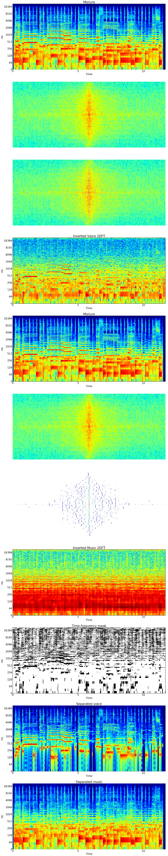

Classifying song spectrograms
Y = 0 (FLOP SONG)
Y = 1 (HIT SONG)
M = 1024
N = 600
Each image is an m by n array of pixel values
Each image is a point in an $mn$ dimensional space
The right weights make a $mn$ hyperplane to separate the images
How do we pick those weights?

Slide 17
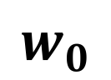
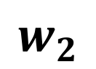
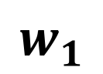
Pick model M
Right now, it is a single perceptron unit with some small set of weights w
Later, we will combine units (thousands of them) and have many weights (millions)
Choosing the types of unit
and how they are connected
is a challenge.
1
$$w_{0}$$
x₁
$$w_{1}$$
x₂
$$w_{2}$$

Slide 18
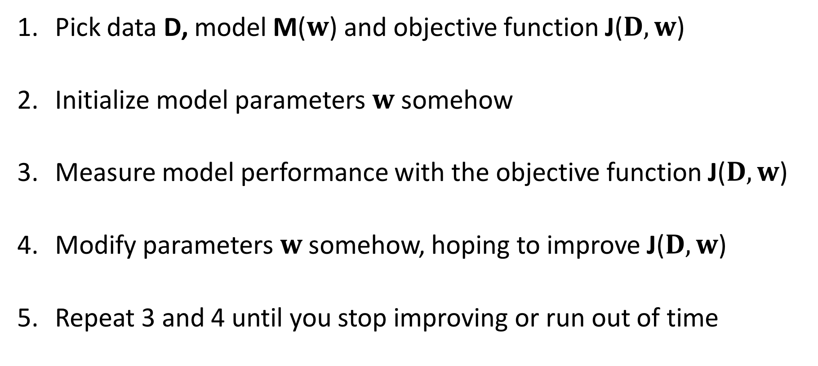
Machine Learning in one slide
Pick data D, model M($w$) and objective function J($D,w$)
Initialize model parameters $w$ somehow
Measure model performance with the objective function J($D,w$)
Modify parameters $w$somehow, hoping to improve J($D,w$)
Repeat 3 and 4 until you stop improving or run out of time

Slide 19
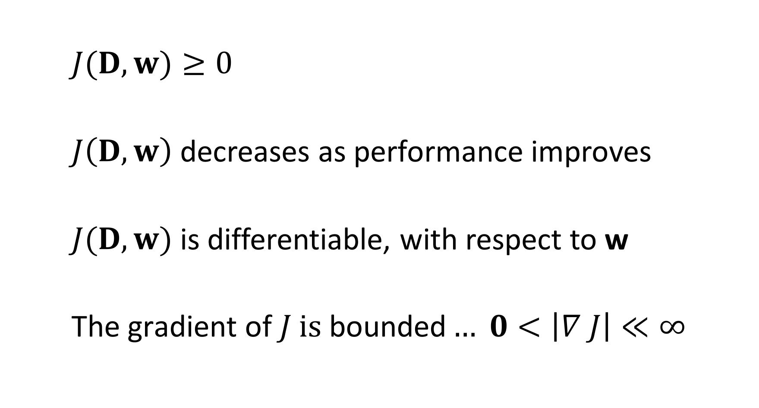
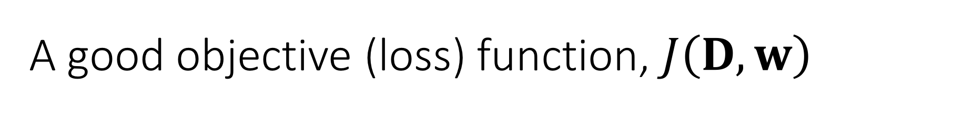
A good objective (loss) function, $J\left(D,w\right)$
$J(D,w)≥0$
$J\left(D,w\right)$ decreases as performance improves
$J(D,w)$ is differentiable, with respect to w
$\text{The} \text{gradient} \text{of} J \text{is} \text{bounded}… 0<\left|∇ J\right|≪∞$
Data
weights
Required
Required
for gradient
descent
Really
helpful

Slide 20
Example objective J : sum of squared errors (SSE)
SSE is same everywhere in the blue
Gradient 0 in the blue region!

Slide 21
Combining perceptrons can make any Boolean function
x₀
0
x₁
0.6
x₀
1
1
XOR
-0.6
x₀
-0.6
0
1
x₂
0.6
…if you can set the weights & connections right

Slide 22
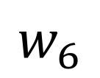
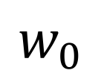
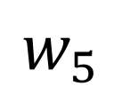
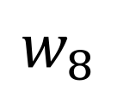
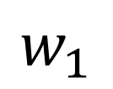
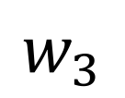
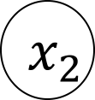
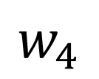
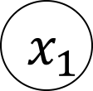
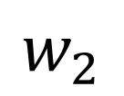
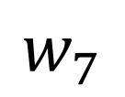
Problem with a step function: Assignment of error
1
Stymies multi-layer weight learning
Limits us to a single layer of units
Thus, only linear functions
You can hand-wire XOR perceptrons, but the sytem can’t learn XOR with perceptrons
$$w_{0}$$
1
$$w_{1}$$
$$x_{1}$$
$$w_{7}$$
$$w_{5}$$
$$w_{2}$$
$$w_{3}$$
$$w_{6}$$
$$x_{2}$$
$$w_{4}$$
$$w_{8}$$
1

Slide 23
Linear Units & Delta Rule

Slide 24

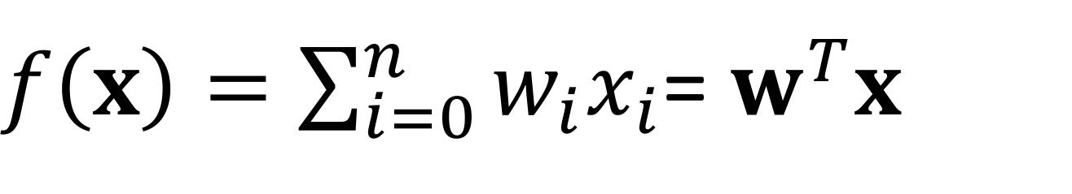

Solution: Remove the step function
$$f\left(x\right)$$
$$w^{T}x$$
$f\left(x\right)=\sum_{i=0}^{n}{w_{i}x_{i}}$= $w^{T}x$

Slide 25
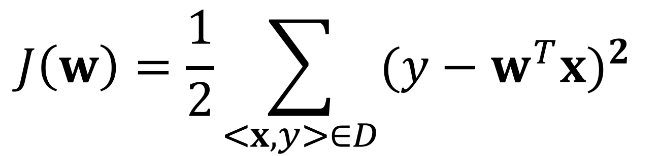
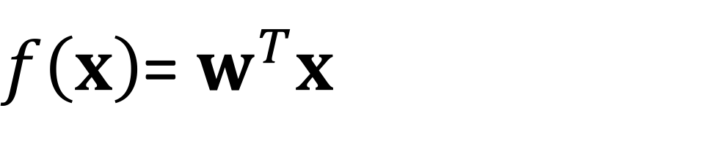
Measuring error for linear units
Output Function
Objective Function:
$f\left(x\right)$= $w^{T}x$
Correct
output
Model
output
$$J\left(w\right)=\frac{1}{2}\sum_{<x,y>∈D}{{({y−w}^{T}x)}^{2} }$$
Dataset

Slide 26

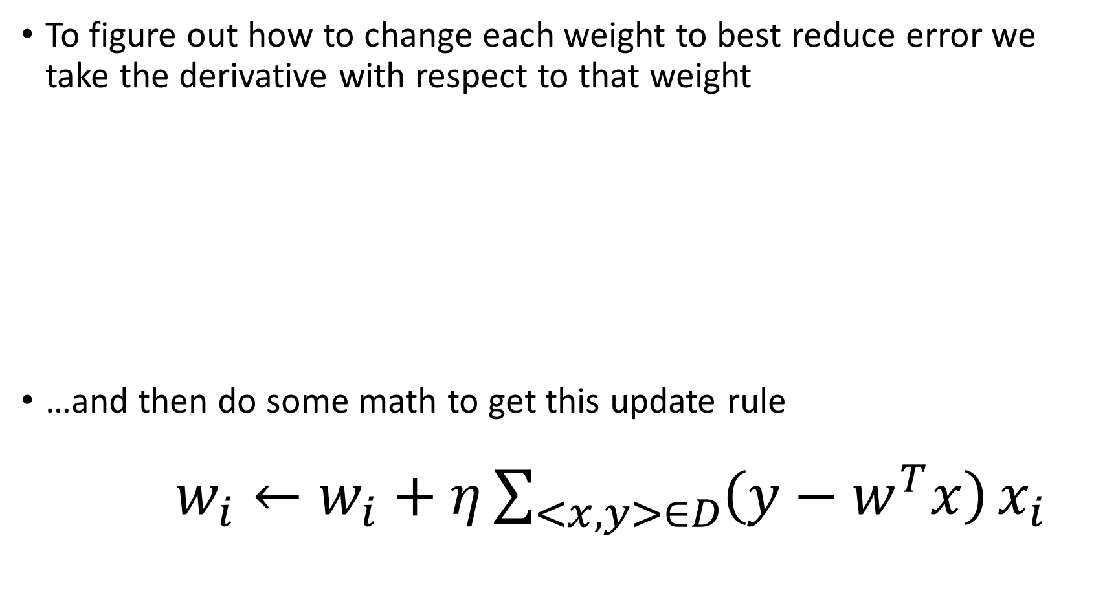
Gradient Decsent Rule
To figure out how to change each weight to best reduce error we take the derivative with respect to that weight
…and then do some math to get this update rule
$w_{i}←w_{i}+η\sum_{<x,y>∈D}{\left(y−w^{T}x\right)}x_{i}$
$$\frac{∂J}{∂w_{i}}≡\frac{1}{2}\frac{∂}{∂w_{i}}\sum_{<x,y>∈D}{{({y−w}^{T}x)}^{2} }$$

Slide 27
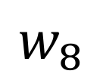
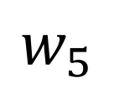
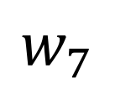
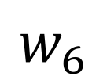
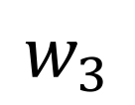
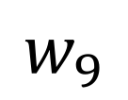
Better & worse than a perceptron
1
All changes in input result in changed output
This gives us a gradient everywhere
We can learn multiple layers of weights.
Combining linear functions only gives you linear functions
you can’t represent XOR
$$w_{5}$$
1
$$w_{1}$$
$$x_{1}$$
$$w_{7}$$
$$w_{9}$$
$$w_{2}$$
$$w_{3}$$
$$w_{8}$$
$$x_{2}$$
$$w_{4}$$
$$w_{6}$$
1

Slide 28
Many linear units: Only linear decisions
This is XOR.
A multilayer perceptron with linear units CANNOT learn XOR

Slide 29
The Sigmoid Unit
Rumelhart, David E., James L. McClelland, and PDP Research Group. Parallel distributed processing. Vol. 1. Cambridge, MA, USA:: MIT press, 1987.

Slide 30
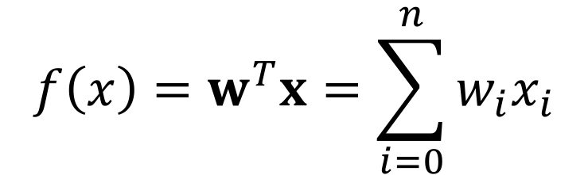
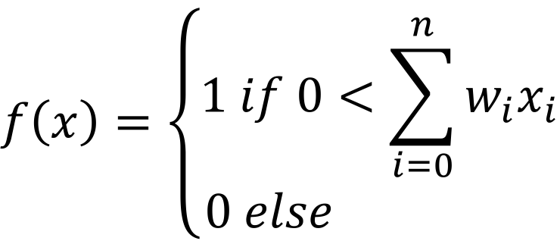
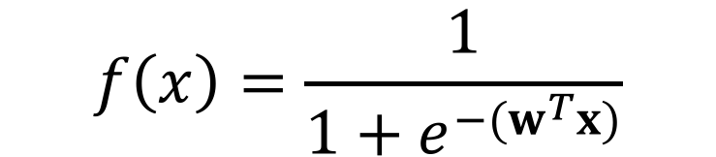
Sigmoid (aka Logistic) function: best of both
$$f\left(x\right)=\left\{\begin{matrix}1 if 0<\sum_{i=0}^{n}{w_{i}x_{i}} \\ 0 else \end{matrix}\right.$$
Perceptron
Linear
Sigmoid
$$f\left(x\right)=w^{T}x=\sum_{i=0}^{n}{w_{i}x_{i}}$$
$$f\left(x\right)=\frac{1}{1+e^{−(w^{T}x)}}$$

Slide 31
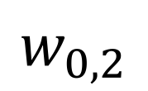
A network of sigmoid units
Small changes in input result in output
This gives us a gradient everywhere
We can learn multiple layers of weights.
Combining layers gives non-linear functions
1
$$w_{0}$$
1
$$w_{1}$$
$$x_{1}$$
$$w_{7}$$
$$w_{5}$$
$$w_{2}$$
$$w_{3}$$
$$w_{6}$$
$$x_{2}$$
$$w_{4}$$
$$w_{0,2}$$
1

Slide 32
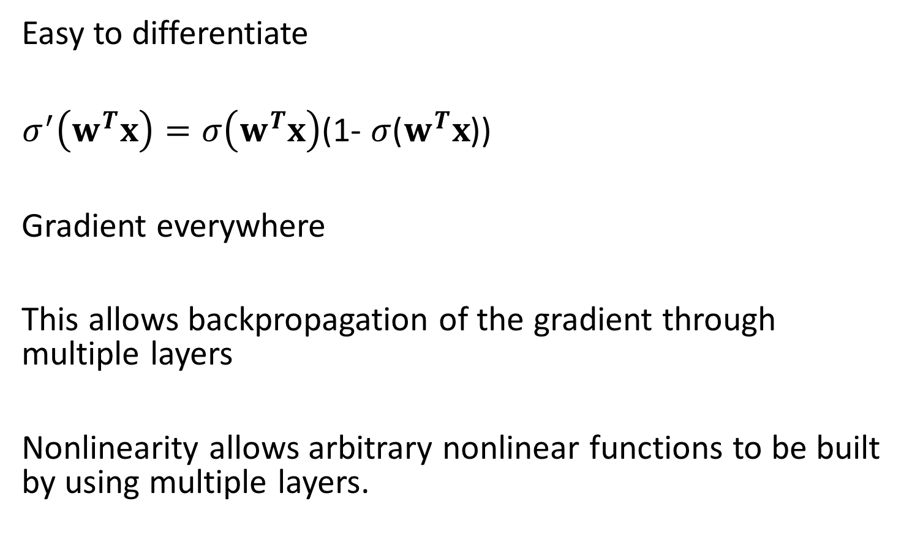
Sigmoid changes (almost) everything
Easy to differentiate
$σ^{′}\left(w^{T}x\right)=σ\left(w^{T}x\right)$(1- $σ$($w^{T}x$))
Gradient everywhere
This allows backpropagation of the gradient through multiple layers
Nonlinearity allows arbitrary nonlinear functions to be built by using multiple layers.

Slide 33
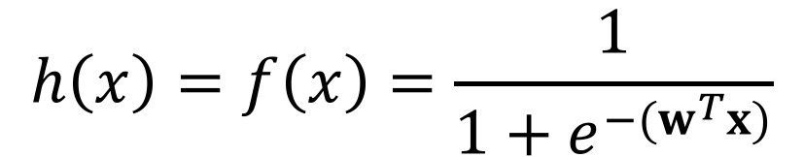
Example objective J : sum of squared errors
$$h\left(x\right)=f\left(x\right)=\frac{1}{1+e^{−(w^{T}x)}}$$
Gradient non-zero everywhere!

Slide 34
Multilayer Perceptron with sigmoid units
This is XOR.
A multilayer perceptron with sigmoid units CAN learn XOR…or any other arbitrary Boolean function.

Slide 35
The promise of many layers
Each layer learns an abstraction of its input representation (we hope)
As we go up the layers, representations become increasingly abstract
The hope is that the intermediate abstractions facilitate learning functions that require non-local connections in the input space (recognizing rotated & translated digits in images, for example)
Modern neural networks are up to 100 layers deep

Slide 36
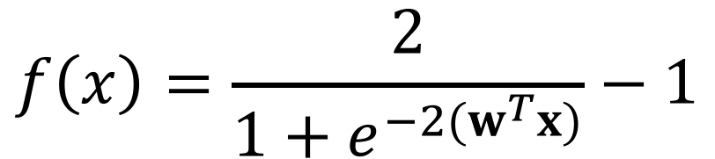
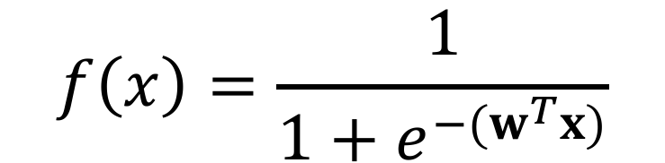
TanH: A shifted sigmoid
$$f\left(x\right)=\frac{1}{1+e^{−(w^{T}x)}}$$
Sigmoid
TanH
$$f\left(x\right)=\frac{2}{1+e^{−2(w^{T}x)}}−1$$

Slide 37
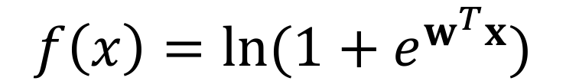
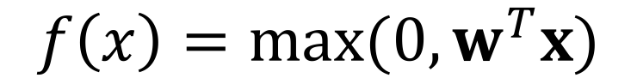
Rectified Linear Unit (ReLU) & Soft Plus :
ReLU
Soft Plus
Both can be combined in layers to make non-linear functions
$$f\left(x\right)=max⁡(0,w^{T}x)$$
$$f\left(x\right)=ln⁡(1+e^{w^{T}x})$$

Slide 38
“One Hot” Encoding
A vector of values where a single element is 1 and all the rest are 0
Common way to encode the true label, y, in a multi-class labeling problem
Can be interpreted as a probability distribution
y = 0 0 1 0 0 0 0 0 0 0
y = 0 0 0 0 0 1 0 0 0 0

Slide 39
Probability distribution

Slide 40
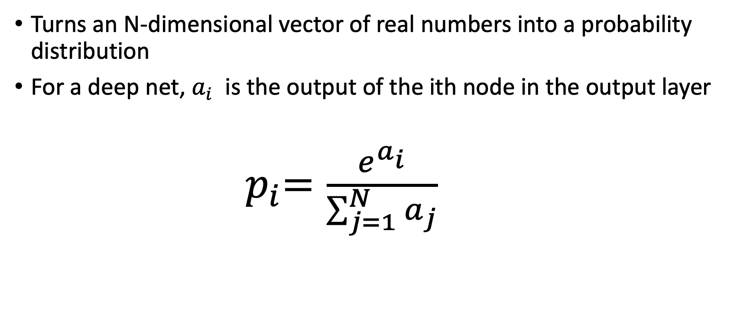
Soft Max Function
Turns an N-dimensional vector of real numbers into a probability distribution
For a deep net, $a_{i}$ is the output of the ith node in the output layer
${ p}_{i}=\frac{e^{a_{i}}}{\sum_{j=1}^{N}{a_{j}}}$

Slide 41
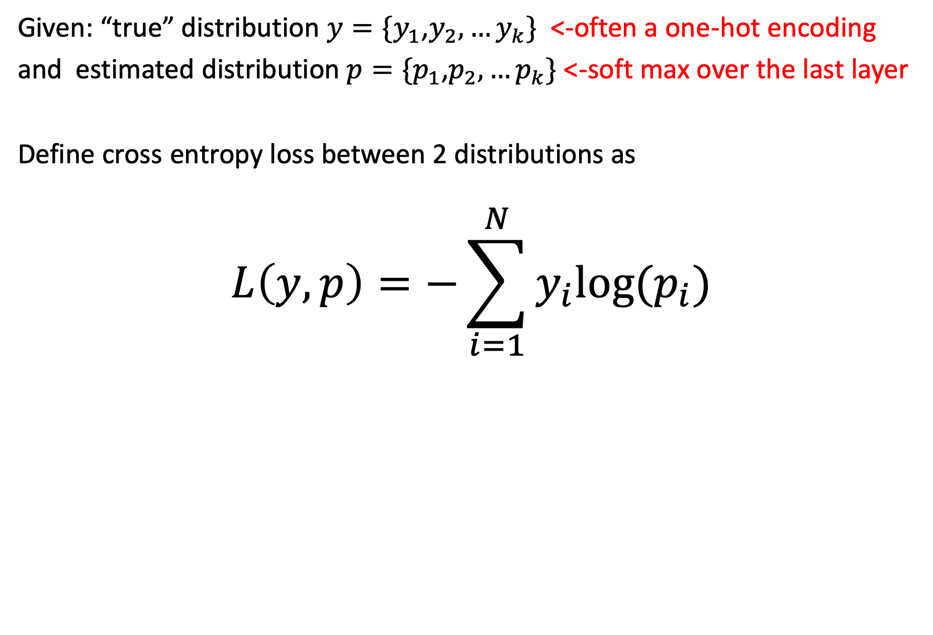
Cross Entropy Loss Function
Given: “true” distribution $y=\{y_{1}$,$y_{2},…y_{k}\}$ <-often a one-hot encoding
and estimated distribution $p=\{p_{1}$,$p_{2},…p_{k}\}$ <-soft max over the last layer
Define cross entropy loss between 2 distributions as
$$L\left(y,p\right)=−\sum_{i=1}^{N}{y_{i}log⁡(p_{i}})$$

Slide 42
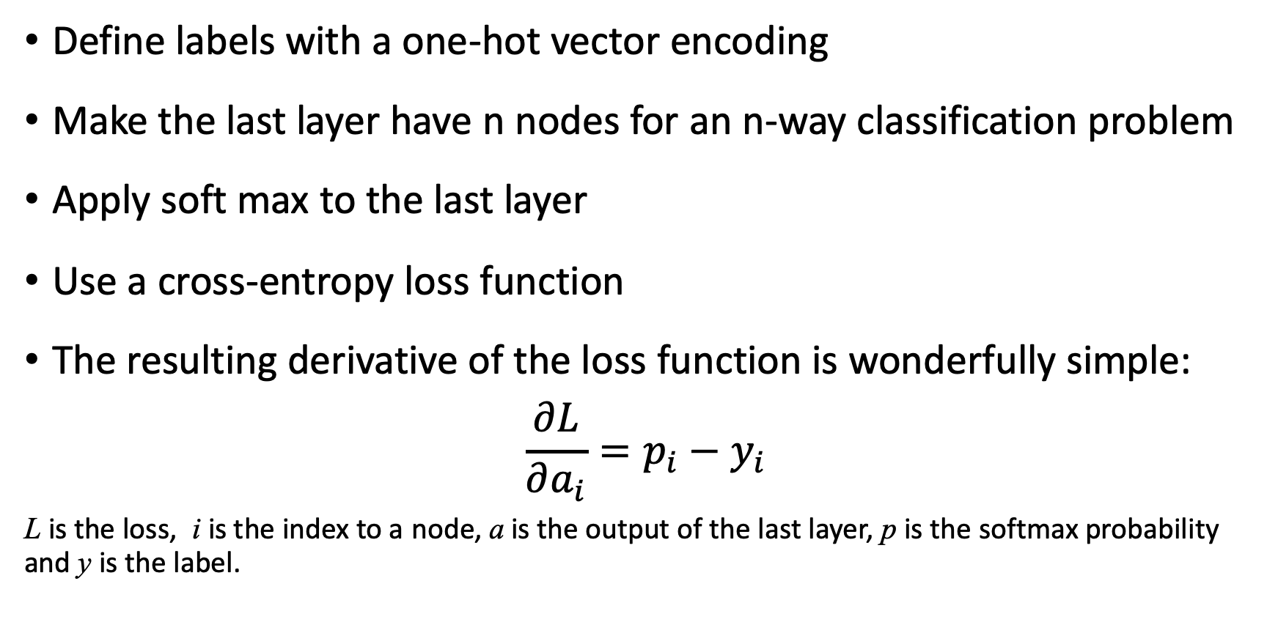
A common approach…
Define labels with a one-hot vector encoding
Make the last layer have n nodes for an n-way classification problem
Apply soft max to the last layer
Use a cross-entropy loss function
The resulting derivative of the loss function is wonderfully simple:
$$\frac{∂L}{∂a_{i}}=p_{i}−y_{i}$$
L is the loss, i is the index to a node, a is the output of the last layer, p is the softmax probability and y is the label.

Slide 43
Classifying images of digits

Slide 44
Design choices
Define the function you want to learn
Determine an encoding for the data
Pick a network architecture
Number of layers (between 3 and 100)
Activation functions function (tanh,ReLU, linear)
Select how units connect within and between layers
Pick a gradient descent algorithm
Pick regularization approach (e.g. dropout)

Slide 45
A possibility: one fully-connected hidden layer
INPUT LAYER
HIDDEN LAYER
OUTPUT LAYER
0
1
2
3
4
5
6
7
One input
per pixel
8
9
One hidden node per
potential shifted image
(what activation function?)
One output node
per category
(Sigmoid? ReLU?)
Each node is connected to EVERY node in the prior layer
(it is just too many lines to draw)

Slide 46
Another possibility
INPUT LAYER
HIDDEN 1
HIDDEN 2
HIDDEN 3
OUTPUT
1
2
3
4
5
6
7
8
One input
per pixel
9
ReLU
Max Pool
Linear
Sigmoid
HUGE DESIGN SPACE!

Slide 47
Convolutional networks
LeCun, Yann, and Yoshua Bengio. "Convolutional networks for images, speech, and time series." The handbook of brain theory and neural networks3361.10 (1995): 1995.
Notes:
Rosenblatt, Frank. "The perceptron: A probabilistic model for information storage and organization in the brain." Psychological review 65.6 (1958): 386.

Slide 48
How big is that image?
500
1000

Slide 49



How many weights in a fully connected net?
Input
Layer
Hidden
Layer
Hidden
Layer
Output
Layer
$$\left(100∙50\right)$$
Unique
weights
$$\left(50∙2\right)$$
Unique
Weights
M = 500
$$\left(500000∙100\right)$$
Unique weights
100
Nodes
50
Nodes
2
Nodes
N = 1000
$50,000,000+5,000+100=50,$005,100 weights

Slide 50

Fitting & Hypothesis space
If a model’s hypothesis space is too big, it can learn a crazy, overly specific function (overfitting)
Y
$$y=\sum_{i=0}^{10}{w_{i}x^{i}}$$
X

Slide 51
Small Fixed Windows (filter size/receptive field)
If important features fall within a bounded size region, we can bound the receptive field of each unit to that size.
This greatly reduces the number of weights.

Slide 52
Shared weights
If a feature is good to find in one region, it may be good to find in other regions.
Units look for the same feature if they share weights.
A set of units that share weights is a feature map.

Slide 53


Building that feature map
Input X
The shared weights W
(AKA a filter, AKA a feature)
Filtered values
$$=$$
Feature map
A shared activation function
$$f\left(x\right)=w^{T}x$$

Slide 54
Building that feature map
Input X
The shared weights W
(AKA a filter, AKA a feature)
Filtered values
$$=$$
Feature map
A shared activation function
$$f\left(x\right)=w^{T}x$$

Slide 55
Building that feature map
Input X
The shared weights W
(AKA a filter, AKA a feature)
Filtered values
$$=$$
Feature map
A shared activation function
$$f\left(x\right)=w^{T}x$$

Slide 56
Building that feature map
Input X
The shared weights W
(AKA a filter, AKA a feature)
Filtered values
$$=$$
Feature map
A shared activation function
$$f\left(x\right)=w^{T}x$$

Slide 57
Multiple Feature Maps
To look for multiple features, use multiple feature maps.
Each map will specialize on one thing.
Even with many feature maps, you still have far fewer weights

Slide 58




How many weights in a convolutional net?
3 feature maps
of 200 nodes.
Receptive fields: 50 by 100
Input
Layer
Fully connected
layer of 25 nodes
2 fully
connected nodes
M = 500
$$\left(3∙50∙100\right)$$
unique
weights
$$\left(600∙25\right)$$
unique
weight
$$\left(25∙2\right)$$
unique
weights
N = 1000
$15,000+15,000+50=30$,050 unique weights
Compare that to the $50,$005,100 weights in the other network

Slide 59
Is that enough reduction?
That picture of the adorable Capybara was 500,000 pixels.
The 2017 iPhone X takes 12 megapixel images. That’s 24 times as big.
Making the network on the previous slide 24 times bigger would have us at over 600,000 weights.
Can we do some kind of down sampling on our data?

Slide 60

Max Pool Layer: A kind of downsampling
Max Pool
$$f\left(x\right)=max⁡(x_{1},x_{2},…x_{n})$$
LAYER N LAYER N+1

Slide 61
Max Pool Layer: A kind of downsampling
Max Pool
$$f\left(x\right)=max⁡(x_{1},x_{2},…x_{n})$$
LAYER N LAYER N+1

Slide 62
Max Pool Layer: A kind of downsampling
Max Pool
$$f\left(x\right)=max⁡(x_{1},x_{2},…x_{n})$$
LAYER N LAYER N+1

Slide 63
Max Pool Layer: A kind of downsampling
Max Pool
$$f\left(x\right)=max⁡(x_{1},x_{2},…x_{n})$$
LAYER N LAYER N+1

Slide 64
Max Pool Layer: A kind of downsampling
Max Pool
$$f\left(x\right)=max⁡(x_{1},x_{2},…x_{n})$$
LAYER N LAYER N+1

Slide 65
So…what is a convolutional net?
A network with one or more layers that are feature maps
A layer with feature maps is called a “convolutional layer”
Often, convolutional layers are alternated with pooling layers.
Since these nets have many fewer connections
They train faster
They need fewer training examples

Slide 66
Restricted boltzman machine (RBM)

Slide 67
About RBNs
Related to Hopfield nets
Used extensively in Deep Belief Networks
You can’t understand DBNs without understanding these

Slide 68
About RBNs
Related to Hopfield nets
Used extensively in Deep Belief Networks
You can’t understand DBNs without understanding these

Slide 69

Standard RBM Architecture
Hidden
Units
Weight
Matrix
Input
Units
2 layers (hidden & input) of Boolean nodes
Nodes only connected to the other layer

Slide 70
Standard RBM Architecture
Hidden
Units
Weight
Matrix
Input
Units
Setting the hidden nodes to a vector of values updates the visible nodes…and vice versa

Slide 71
Contrastive Divergence Training
Pick a training example.
Set the input nodes to the values given by the example.
See what activations this gives the hidden nodes.
Set the hidden nodes at the values from step 3.
Set the input node values, given the hidden nodes
Compare the input node values from step 5 to the the input node values from step 2
Update the connection weights to decrease the difference found in step 6.
If that difference falls below some epsilon, quit. Else, go to step 1.

Slide 72
Deep BELIEF Network (DBN)

Slide 73
What is a Deep Belief Network?
A stack of RBNS
Trained bottom to top with Contrastive Divergence
Trained AGAIN with supervised training (similar to backprop in MLPs)
RBN

Slide 74
What is a Deep Belief Network?
A stack of RBNS
Trained bottom to top with Contrastive Divergence
Trained AGAIN with supervised training (similar to backprop in MLPs)
RBN

Slide 75
What is a Deep Belief Network?
A stack of RBNS
Trained bottom to top with Contrastive Divergence
Trained AGAIN with supervised training (similar to backprop in MLPs)
RBN

Slide 76
What is a Deep Belief Network?
A stack of RBNS
Trained bottom to top with Contrastive Divergence
Trained AGAIN with supervised training (similar to backprop in MLPs)
RBN

Slide 77
Why are DBNs important?
Around 2005 they were state-of-the-art systems for doing certain recognition tasks
Handwritten digits
Phonemes
They got the whole “Deep learning” thing going
They have a good marketing campaign “Deep learning” vs “shallow learning”

Slide 78
How does “deep” help?
It may be possible to much more naturally encode problems like the parity problem with deep representations than with shallow ones

Slide 79
Why not use standard MLP training?
Fading signal from backprop
The more complex the network, the more likely there are local minima
Memorization issues
Training set size and time to learn

Slide 80
Benefits
Allowed relatively deep networks (e.g. 10 layers), compared to regular multilayer perceptrons with sigmoid activations
In the mid 2000’s this approach made networks better than anything else out there for some problems (e.g. digit recognition, phoneme recognition)
Today, they’ve been superseded by other approaches

Slide 81
RECURRENT NETS
Werbos, Paul J. "Backpropagation through time: what it does and how to do it." Proceedings of the IEEE 78.10 (1990): 1550-1560.

Slide 82


A complex auditory scene
Music + dishes + people talking

Slide 83
Dealing with time
With a ”standard” feed-forward architecture, you process data from within a window, ignoring everything outside the window.
To get influence from the processing of earlier time steps, add nodes and connections
This doesn’t scale well
t-2
t-1
t
output

Slide 84






Let’s look at that net.
An entire new set of weights for EACH time step.
Audio is sampled at 44,100 times per second
The number of past time steps you could consider is limited by the architecture.
The number of weights to learn quickly gets out of control.
t-2
t-1
t
$$W_{t−2}$$
$$W_{t−1}$$
$$W_{t}$$
$$X_{t−2}$$
$$X_{t−1}$$
$$X_{t}$$

Slide 85





Take an idea from CNNs and HMMs
Markov property: The state of the world can be captured by knowing current state + immediately previous state
Markov models use recurrent connections
CNNs use the same set of shared weights on different parts of the input
Shared
weights
$$W$$
$$W$$
$$W$$
Distinct
inputs
$$X_{t−1}$$
$$X_{t−2}$$
$$X_{t}$$

Slide 86


Take an idea from CNNs and HMMs
If all the windows share the same input weights (like in a feature map), then we only have the same number of weights as if we had a single window.
This is a recurrent net.
How do you train this?
Are there any obvious limitations?
Recurrent
connection
$$W$$
$$X_{t}$$

Slide 87
Take an idea from CNNs and HMMs
Current output
If all the windows share the same input weights (like in a feature map), then we only have the same number of weights as if we had a single window.
This is a recurrent net.
How do you train this?
Are there any obvious limitations?
Out from t-1
In to t+1
$$W$$
$$X_{t}$$

Slide 88
Backprop through time: “Unrolling”
Pick a number of steps over which you’re going to “unroll” the net.
Treat it like you’re training a convolutional neural net
Pick the number of steps based on your frenemy: Exponential decay

Slide 89
Exponentially decaying influence
If your network needs to connect information from a distant timestep, the influence of the earlier one tends to get lost
Why? Exponential decay.

Slide 90
One potential fix: Skip connections (used in Highway networks)
Definitely helps
Widely used
Still has limited range

Slide 91
Long-Short Term Memories
Hochreiter, Sepp, and Jürgen Schmidhuber. "Long short-term memory." Neural computation 9.8 (1997): 1735-1780.

Slide 92

Long Short Term Memory Units (LSTMs)
Added a way of storing data over many time steps without decay
Let networks to handle problems with long term dependencies
Image from: Hochreiter, Sepp, and Jürgen Schmidhuber. "Long short-term memory." Neural computation 9.8 (1997): 1735-1780.

Slide 93
LSTM training
Error is propagated indefinitely through its memory cell (CEC)
Error flow back through the unit is truncated at the incoming weights.
Image from: Hochreiter, Sepp, and Jürgen Schmidhuber. "Long short-term memory." Neural computation 9.8 (1997): 1735-1780.

Slide 94
LSTM Plusses and Minuses
Let networks to handle problems with long term dependencies
This lets LSTMs solve problems other recurrent nets cannot
Still has trouble with XOR (time-delayed XOR where you XOR two inputs that are an unknown number of time steps apart)
Lots of extra weights compared to regular cells
Long and slow to train
Not easy to inspect networks to understand them

Slide 95
Data collection & augmentation

Slide 96

Pick data D
The data defines a function to learn: $f\left(x\right)=y$
Typically, this is from $ℝ^{d}$ to $ℝ^{d}$.
This is called regression.
Y
X

Slide 97

Pick data D
The data defines a function to learn: $f\left(x\right)=y$
This can also be from $ℝ^{d}$ to a finite set of labels, e.g. {0,1}.
This is classification.
1
Y
0
X

Slide 98
Pick data D: Is there enough?
Good coverage of the range of possible values?
Just because you got lots of data, doesn’t mean it covers the space.
Y
X

Slide 99
Pick data D: Is there enough?
Enough density in the space?
Just because you cover the range, doesn’t mean you captured the function.
Y
X

Slide 100

Fitting & Hypothesis space.
If a model’s hypothesis space is too small, the true function is probably not in its vocabulary (underfitting)
Y
$$y= w_{0}+w_{1}x$$
Learnable weights
X

Slide 101
Fitting & Hypothesis space
If a model’s hypothesis space is too big, it can learn a crazy, overly specific function (overfitting)
Y
$$y=\sum_{i=0}^{10}{w_{i}x^{i}}$$
X

Slide 102
Dimensions and data
The more dimensions your data has, the more data you need to cover the space
The more dimensions, the more parameters your model needs (at least 1 per dimension)
The more parameters, the more data you need to prevent overfitting
Conclusion: You probably don’t have enough data. You probably overfit somehow.

Slide 103
Data Augmentation
Make perturbed copies of your data that vary in ways that should not change the value nature of the output function.
This can help prevent spurious correlations between data and output.
Example: Distinguishing clarinet sounds from flute sounds
Vary the pitch of each note by + or – 1%, 2%, 3%, 4%....
Add background noise of different kinds and at different dB
Time-stretch each note a bit
Delay or advance the onset of the note
This can turn 1000 data points into 100,000.

Slide 104
Reduce your patch size, if you can
Use a small patch of the spectrogram as input (e.g. 100 by 100 patch of the spectrogram)
Reduces the number of model parameters needed
Increases the number of training examples
1000 Spectrograms * 600 patches* 100augmentations = 60 million

Slide 105
Conclusions
Deep nets are powerful, but not all-powerful
The design space is very large
Success requires
Lots of patience
Much architecture hacking
Lots of data curation

Slide 106
To get started
Read Deep Learning by Goodfellow, Bengio and Courville
www.deeplearningbook.org
Get the Tensorfow open source library for ML
www.tensorflow.org
Make it easier with TFLearn, a wrapper for Tensorflow
tflearn.org

Slide 107
Stuff we won’t have time for starts HERE

Slide 108
Hebbian Learning

Slide 109
Donald Hebb
A cognitive psychologist active mid 20th century
Influential book: The Organization of Behavior (1949)
Hebb’s postulate
"Let us assume that the persistence or repetition of a reverberatory activity (or "trace") tends to induce lasting cellular changes that add to its stability.… When an axon of cell A is near enough to excite a cell B and repeatedly or persistently takes part in firing it, some growth process or metabolic change takes place in one or both cells such that A's efficiency, as one of the cells firing B, is increased.

Slide 110
Pithy version of Hebb’s postulate
Cells that fire together, wire together.

Slide 111
Hopfield networks

Slide 112
Hopfield nets are
“Hebbian” in their learning approach
Old technology. Nobody uses this. These are proof of concept things from the 80s and earlier.
Fast to train, slower to use
Weights are symmetric
All nodes are input & output nodes
Use binary (1, -1) inputs and output
Used as
Associative memory (image cleanup)
Classifier

Slide 113
Using a Hopfield Net
10 by 10 Training patterns
Query pattern
(to clean or classify)
Output pattern
Fully connected
100 node network
(too complex to draw)

Slide 114
Training a Hopfield Net
Assign connection weights as follows

Slide 115
Using a Hopfield Net
Force output to match an unknown input pattern
Iterate the following function until convergence
Note: this means you have to pick an order for updating nodes. People often update all the nodes in random order

Slide 116
Using a Hopfield Net
Once it has converged…
FOR INPUT CLEANUP: You’re done. Look at the final state of the network.
FOR CLASSIFICATION: Compare the final state of the network to each of your input examples. Classify it as the one it matches best.

Slide 117

Input Training Examples
Why isn’t 5 in the set of examples?

Slide 118
Output of network over 8 iterations
Input pattern
First iteration
After 3 iterations
After 7 iterations

Slide 119

Characterizing “Energy”
As is updated, the state of the system converges on an “attractor”, where
Convergence is measured with this “Energy” function:
Note: people often add a
“bias” term to this function.
I’m assuming we’ve added
an extra “always on”
node to make our “bias”

Slide 120
Limits of Hopfield Networks
Input patterns become confused if they overlap
The number of patterns it can store is about 0.15 times the number of nodes
Retrieval can be slow, if there are a lot of nodes (it can take thousands of updates to converge)

